Slide 1
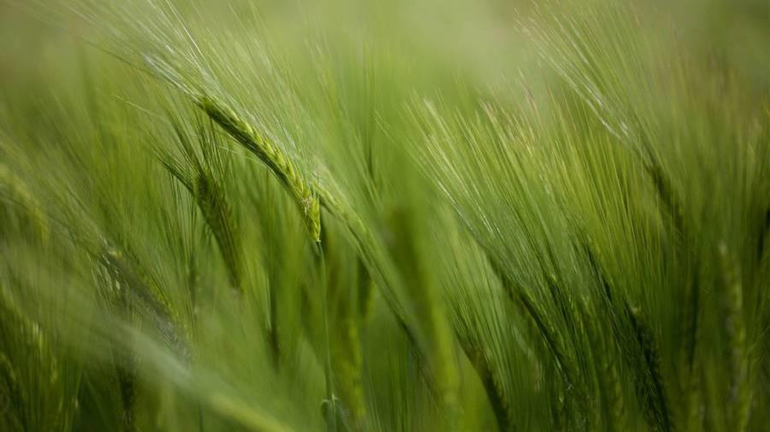
AI Pest & Disease Detection with outbreak Prediction
Team Name: CodeDuet
Theme: AgriTech & Rural Innovation
Team Members: Nistha Arora, Divyata Maurya
Institution: Shri Ramswaroop Memorial University

Slide 2
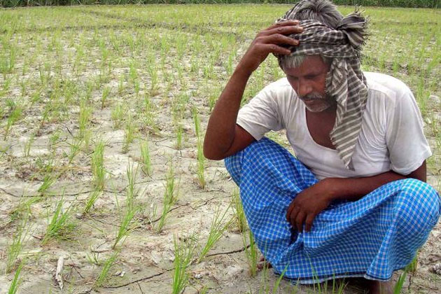
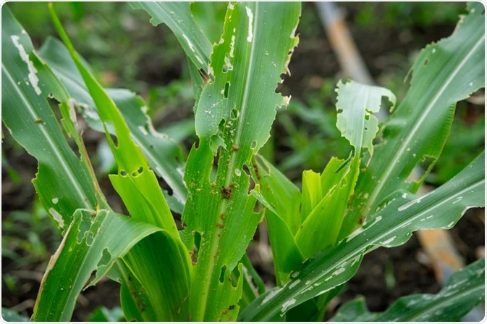
PROBLEM STATEMENT:
Farmers face 30-40% crop yield loss annually due to pest attacks and plant diseases.
Delayed detection causes the entire fields to be affected.
Expert diagnosis is not available in most rural areas . No centralized alert system exists to warn nearby farmers of pest outbreaks.
Farmers are fighting pests blindfolded, they detect too late, act too late, and lose big.

Slide 3
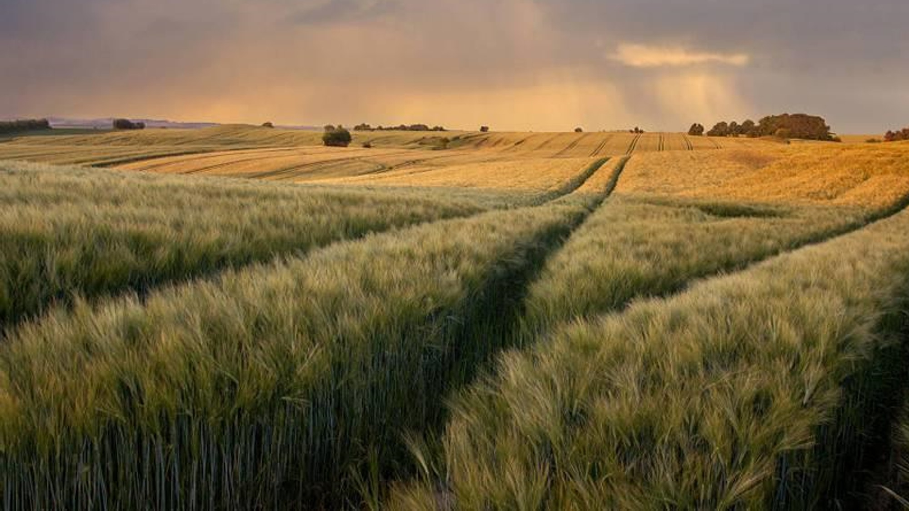
Proposed solution
Meet AgriShileld, an AI powered web app that help farmers:
It uses Convolutional Neural Networks (CNNs) to identify visible signs of diseases and pests on crops (leaves, stems, fruits) from images captured by drones, smartphones. Trained on datasets like PlantVillage, local agricultural images, and crowd-sourced data . Detects: Common plant diseases and pests.
2) Outbreak Prediction Engine Leverages historical data + real-time environmental factors: Temperature, humidity, rainfall Soil health data Seasonal crop patterns Outputs a "Risk Score" for each pest/disease.
3) Farmer & Admin Dashboard Web interface with: Visual crop health map ,Timeline of predicted outbreaks Recommended actions (organic/chemical treatments) and receive:📩 Push notifications / SMS alerts

Slide 4
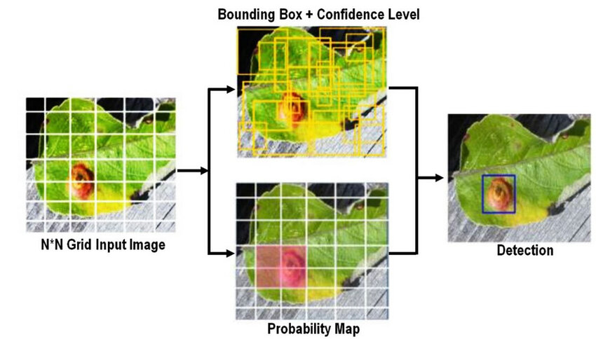
SYSTEMATIC ARCHITECTURE
We can represent this by the flow diagram with 5 key layers:
1. Image Sources Smartphone Cameras: Farmers upload pictures via web.
2. Preprocessing Layer Image Preprocessing: Resizing, noise reduction, augmentation. Segmentation to focus on infected areas. Data Cleaning: Normalize environmental inputs. Fill missing weather/soil data.
3. AI/ML Engine (Core Layer) : Convolutional Neural Network (CNN): Detects pest or disease from images.
Outbreak Prediction Model Uses ML algorithms (e.g., Random Forest, XGBoost, LSTM) to predict outbreaks.
4. Application Layer (User Interaction)a. Farmer Mobile Web App Upload images. View detection results. Receive outbreak alerts.
5. Alert & Recommendation System📩 Push Notifications / SMS: When pest/disease is detected. When an outbreak is predicted. Actionable Insights: Suggested pesticide type/dosage.

Slide 5
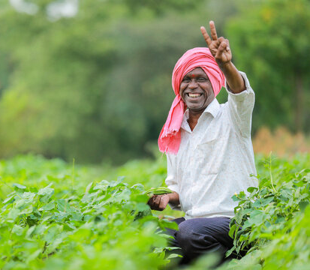
BENEFITS FOR FARMERS:
- Early detection = Prevent crop loss (up to 30–40%)📉 Reduced pesticide cost through targeted usage 24/7 access to AI expertise (even in remote areas)-Increased yield → more income and food security
- For Government:📍 Predictive outbreak maps for planning - and intervention
- Aid in crop insurance validation:📊 Data for policy decisions and subsidies - For Environment Encourages precision farming (less chemical use)🌧 Protects crops sustainably a mid changing climate🐝

Slide 6
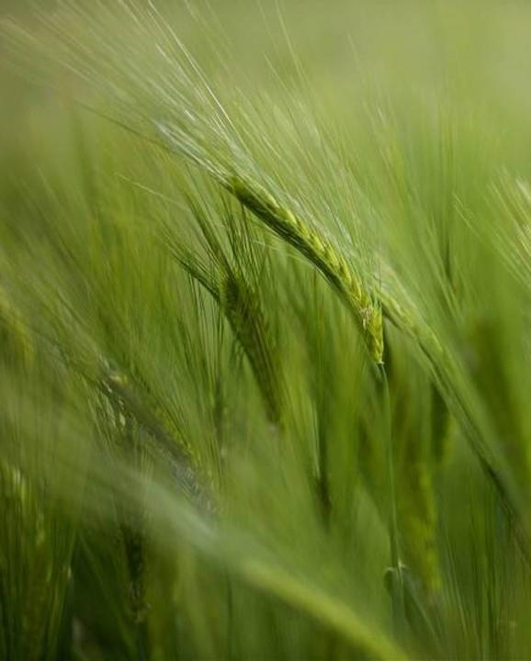
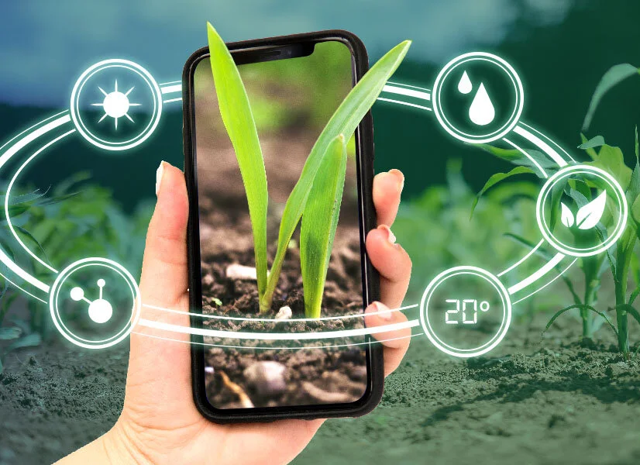
Technical Resources :
- Python: Core programming language for AI/ML
- TensorFlow / PyTorch: Deep learning frameworks (CNNs)
-Scikit-learn / XGBoost: ML models for outbreak prediction
- OpenCV :Image preprocessing and segmentation
Flask / FastAPI: Backend for serving AI models
- React Native / Flutter: app (farmer interface)
Mapbox / Leaflet.js: Geo-mapping of outbreak zones.
Data Resources:
- PlantVillage Dataset: Labeled crop disease/pest images
- Kaggle Pest Datasets: Pest infestation image data
Local Agricultural Boards: Historical pest/disease outbreak data
- OpenWeatherMap / NASA POWER:Real-time and historical weather data

Slide 7
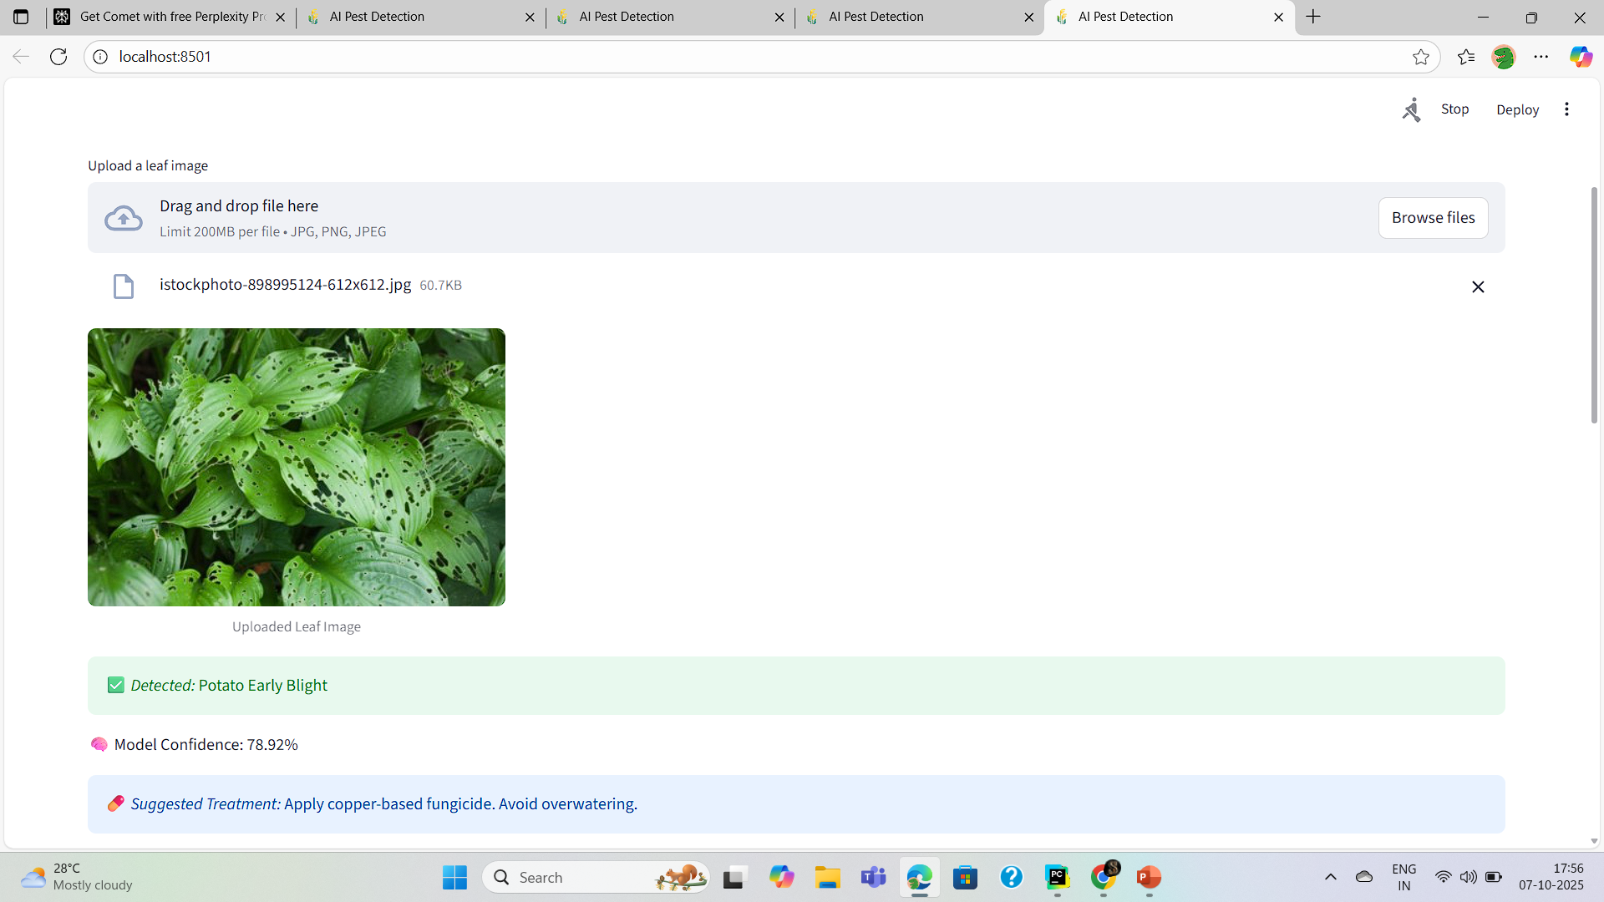
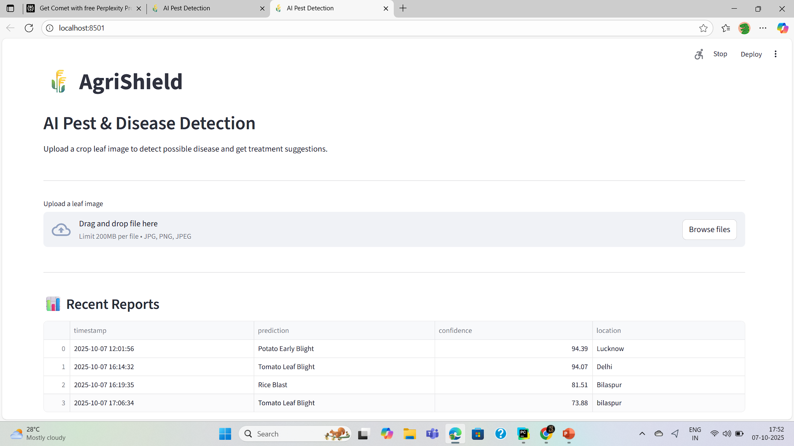
PROTOTYPE

Slide 8
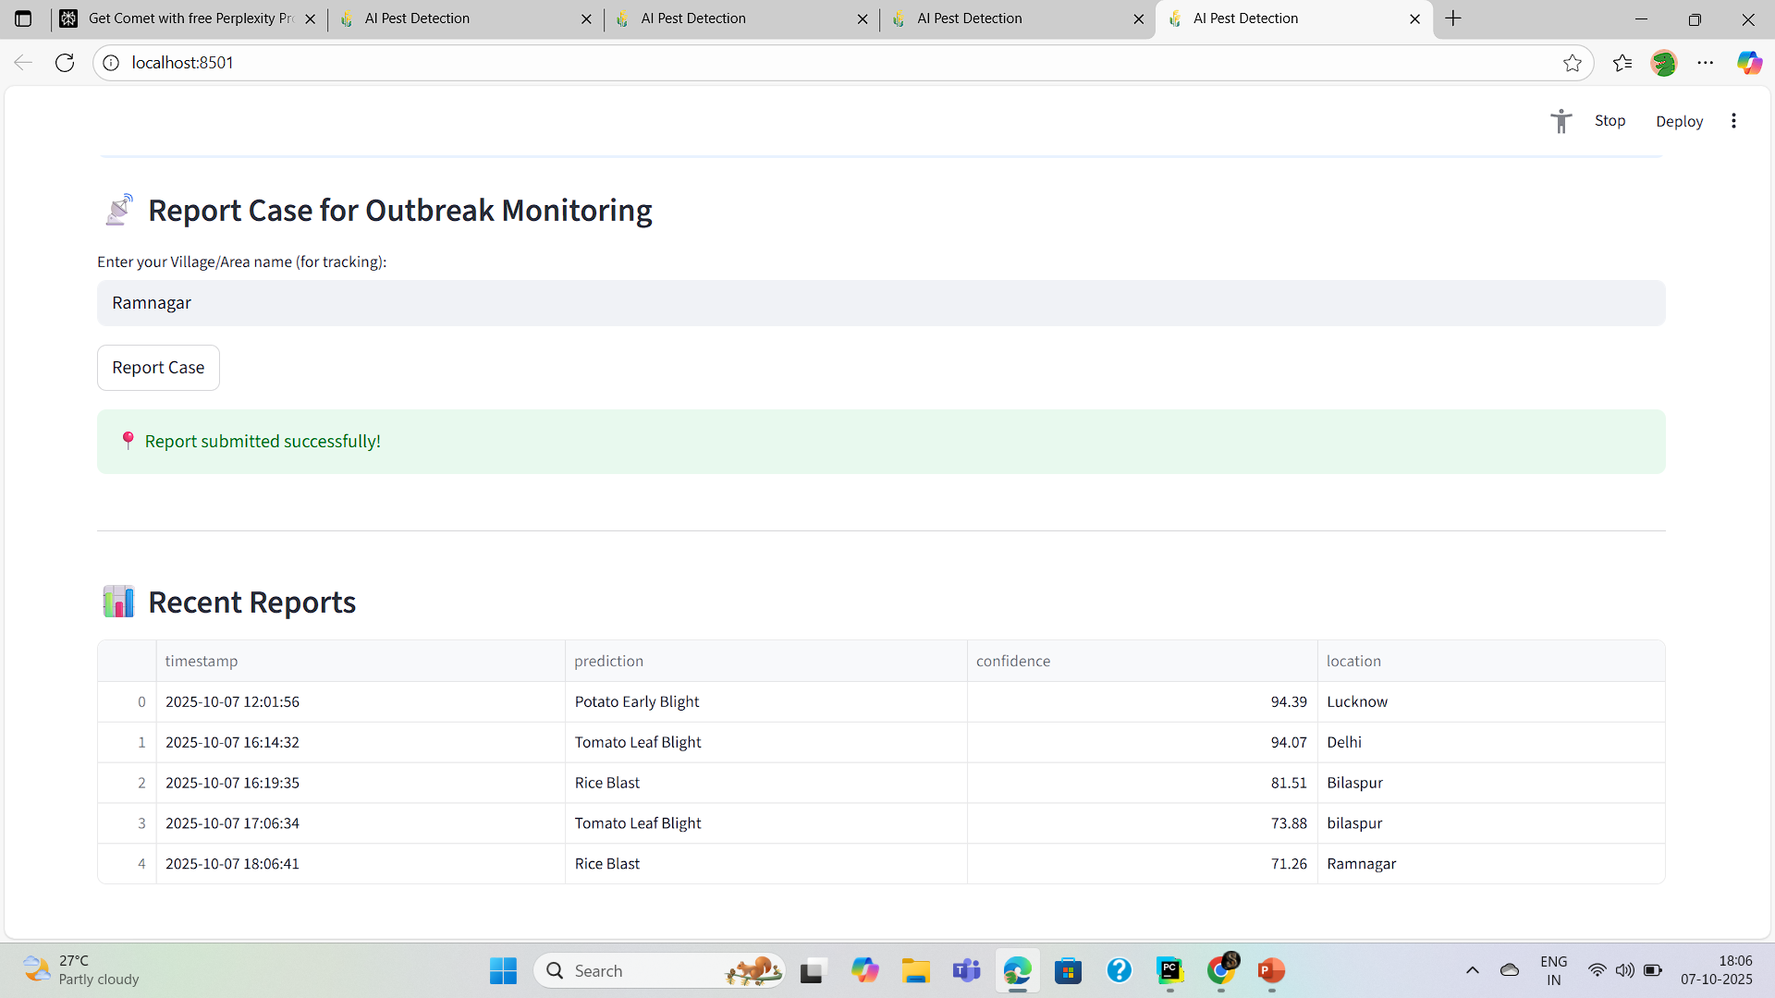
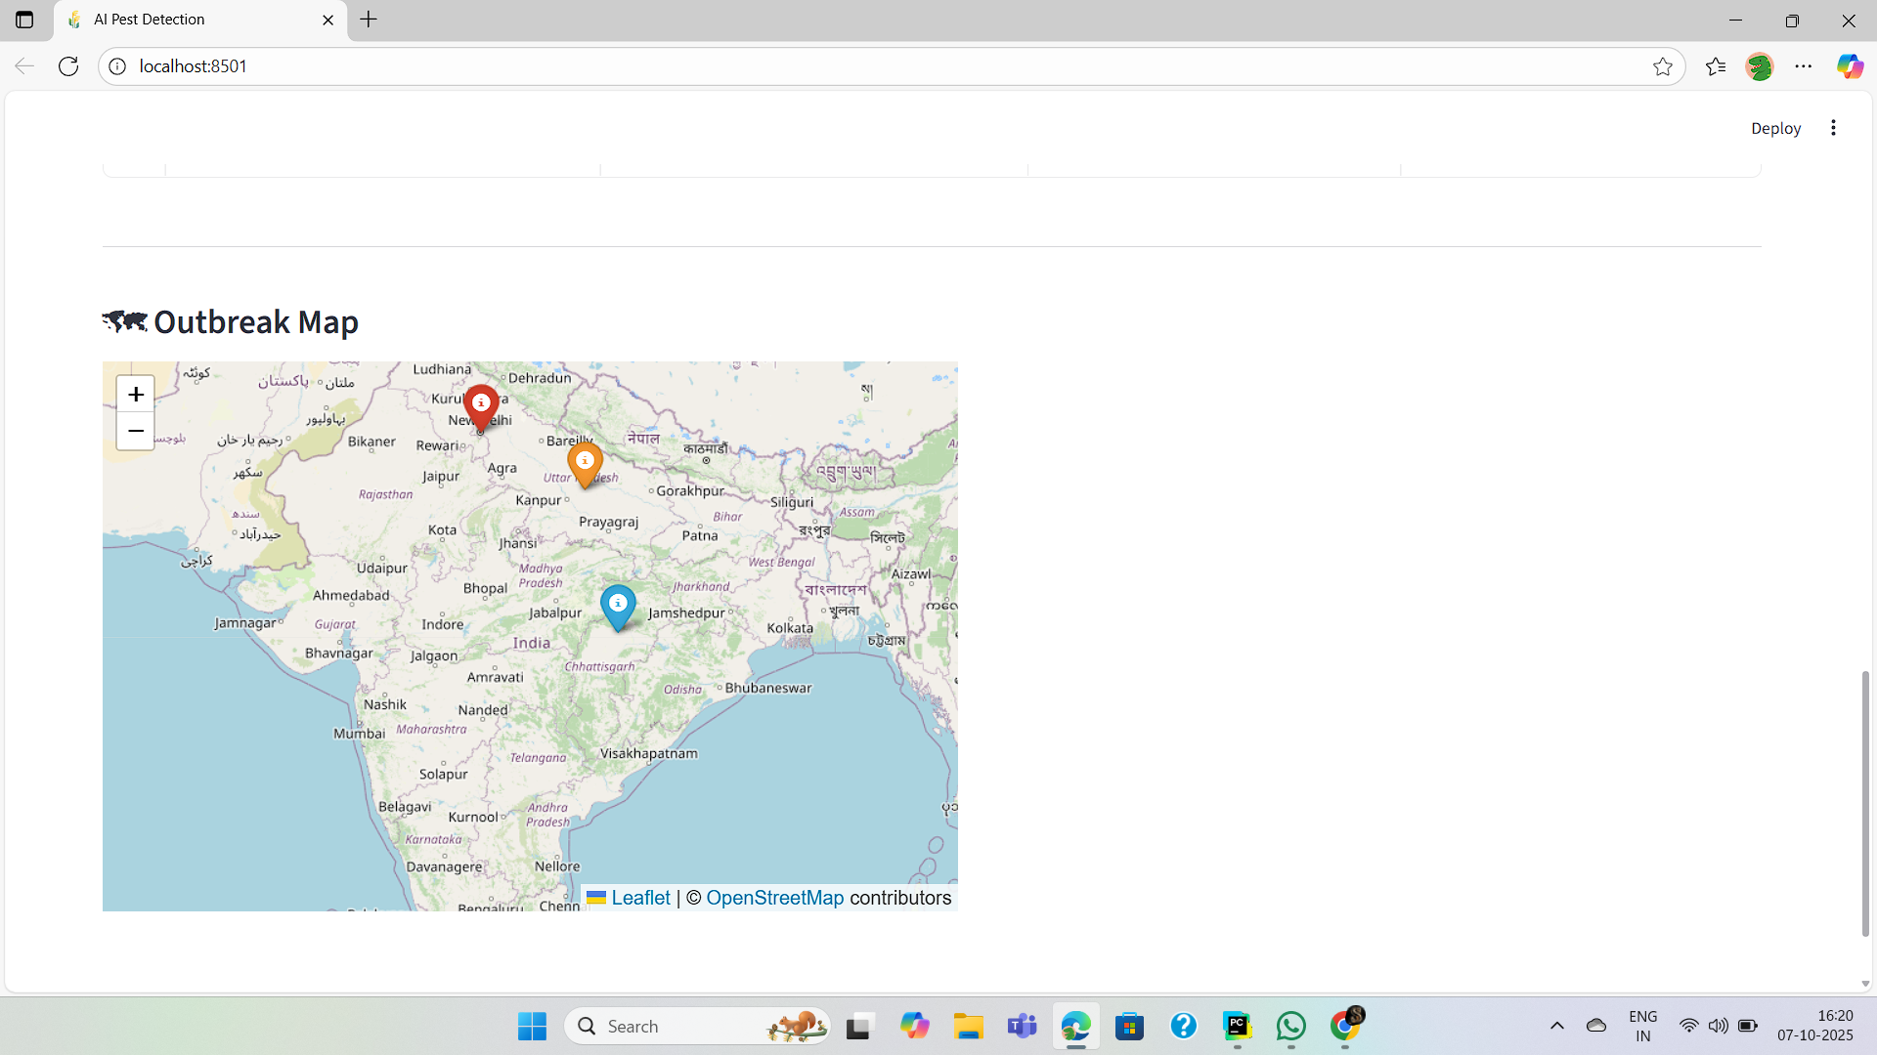

Slide 9
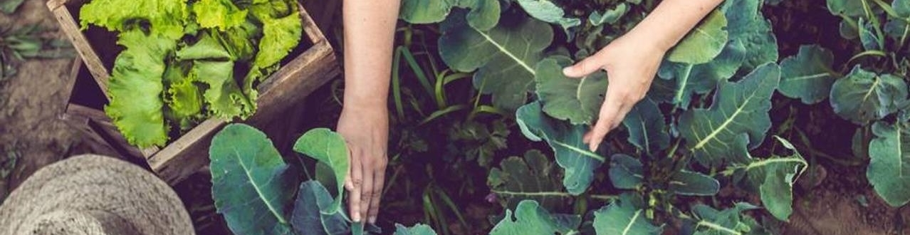
FUTURE SCope
Data Collaboration Platform.
Real time Drone integration.
Automated Treatment Recommendation
Market and Crop Price insights.
Sustainability and environmental impact

Slide 10
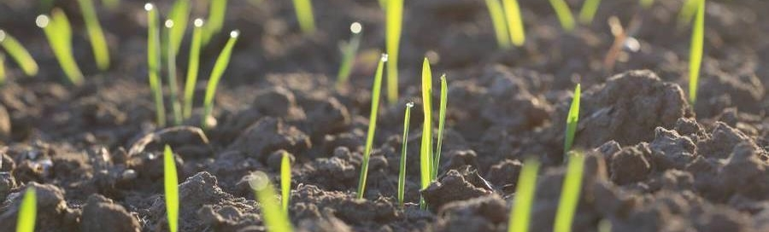
Conclusion
The AI Pest & Disease Detection System provides a quick, affordable, and accessible way for farmers to identify crop issues early.
By using AI and image recognition, farmers can reduce crop losses, save pesticide costs, and improve yield quality.
The system empowers rural communities through technology-driven decision-making and timely alerts .
This innovation contributes to sustainable agriculture, food security, and economic growth for farmers.
“Our vision is to make AI-driven pest detection available to every farmer: from smartphones to smart villages.”

Slide 11
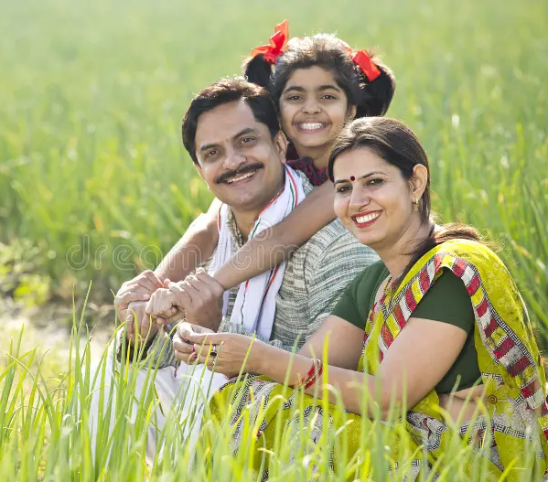
THAnk you

